Slide 1
Turn Off That N se!

Slide 2
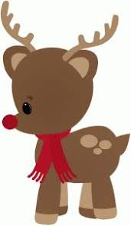
Reindeer, may I have a word?
This is getting so absurd.
I know that you’re Santa’s pal, and that’s okay.
Even so, there’s something I’ve just got to say!

Slide 3
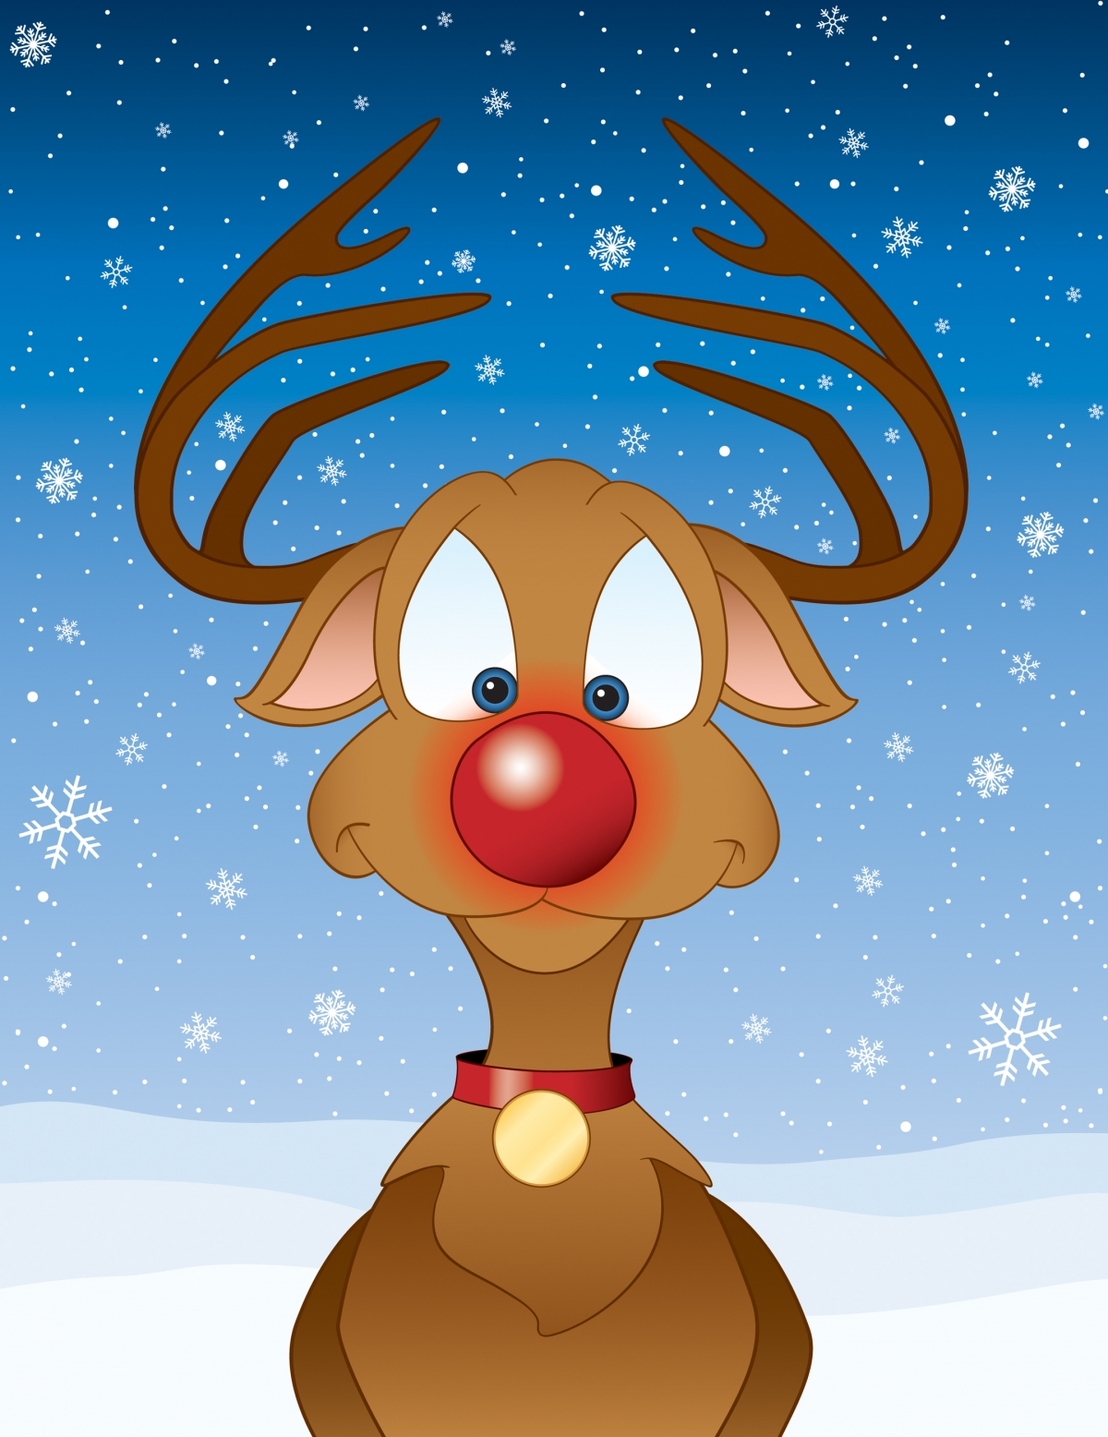
Turn off that nose!
It’s way too bright! You think it’s nice, but it’s not polite.
I’m trying to sleep, but I can’t get a wink.
All because your nose goes and goes, goes and goes blink blink blink blink blink blink blink blink !
Turn it off!
Blink blink blink blink blink .
Please!

Slide 4
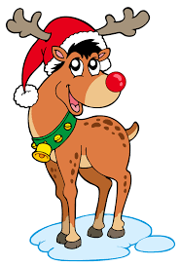
Reindeer, may I speak to you?
Maybe I’m not getting through.
Just because your nose is red and has a glow,
I don’t need to see it bouncing off the snow!

Slide 5
Turn off that nose!
It’s way too bright! You think it’s nice, but it’s not polite.
I’m trying to sleep, but I can’t get a wink.
All because your nose goes and goes, goes and goes blink blink blink blink blink blink blink blink !
Turn it off!
Blink blink blink blink blink .
Please!

Slide 6
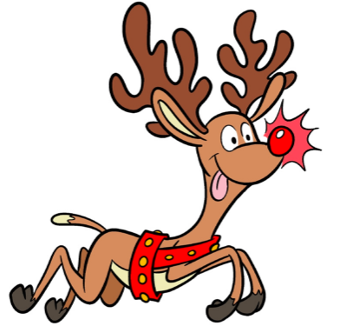
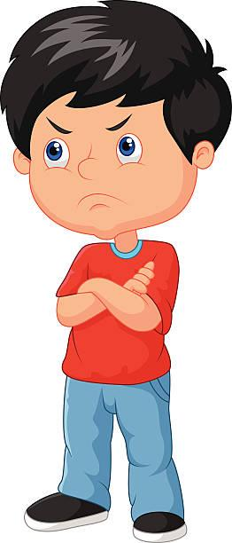
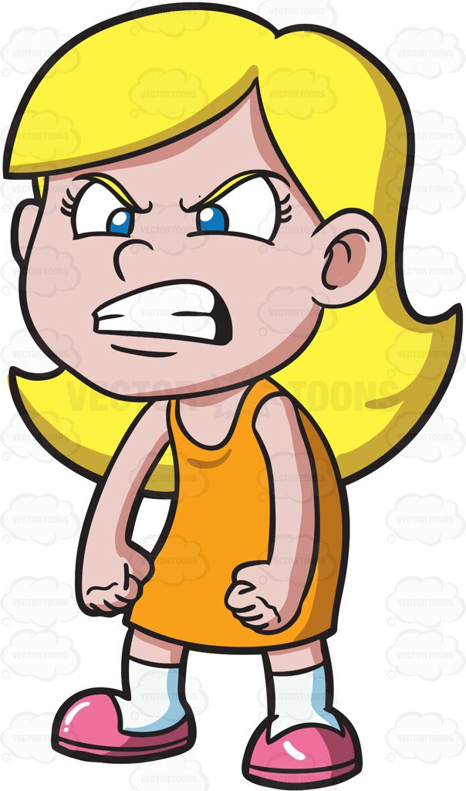
Turn off that nose! I can’t stand it!
Turn off that nose! Blink blink blink blink!
Turn off that nose! I can’t stand it!
Turn off that nose! Blink blink blink blink!
Turn off that nose! Please!!

