Slide 1
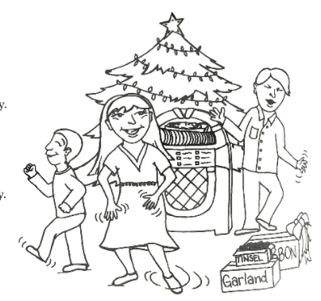
“Rock the Holly”

Slide 2
Rock the holly, rock the ivy, rock the mistletoe

Slide 3
Decorate the tree for everyone to see, oh!

Slide 4
Rock the ribbons and bows!

Slide 5
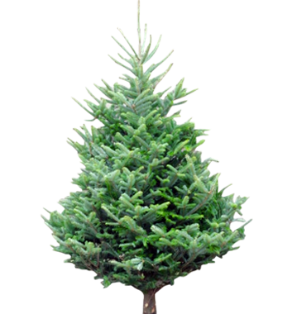
Rock the tinsel, rock the garland, rock the evergreen

Slide 6
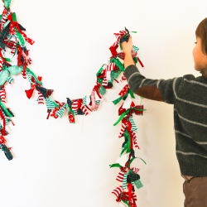
Put it on the walls, it’s time to deck the halls, oh!

Slide 7
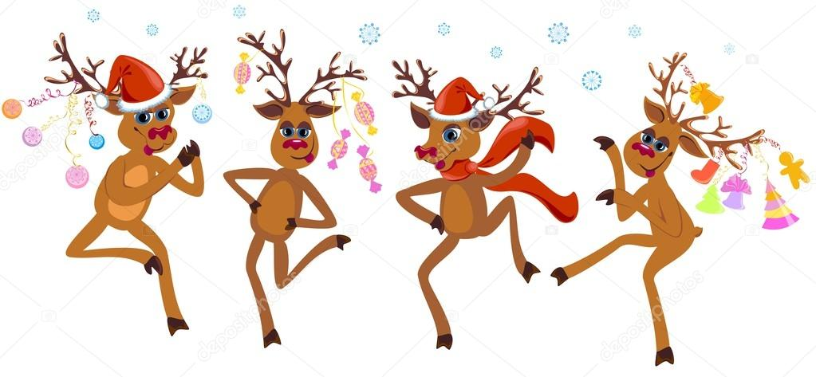
Rock the holiday scene!

Slide 8
Rock around the christmas tree, we’ll rock the day away! Just keep rockin’, it will be a rockin’ holiday!

Slide 9
Rock the holly, rock the ivy, rock the mistletoe

Slide 10
Decorate the tree for everyone to see, oh!

Slide 11
Rock the ribbons and bows!

Slide 12
Rock the tinsel, rock the garland, rock the evergreen

Slide 13
Put it on the walls, it’s time to deck the halls, oh!

Slide 14
Rock the holiday scene!

Slide 15
Rock around the christmas tree, we’ll rock the day away! Just keep rockin’, it will be a rockin’ holiday!

Slide 16
Rock the holly, rock the ivy, rock the mistletoe

Slide 17
Decorate the tree for everyone to see, oh!

Slide 18
Rock the ribbons and bows!

Slide 19
Rock the tinsel, rock the garland, rock the evergreen

Slide 20
Put it on the walls, it’s time to deck the halls, oh!

Slide 21
Rock the holiday scene!

Slide 22
Put it on the walls, it’s time to deck the halls, oh!

Slide 23
Rock the holiday scene!

